Slide 1
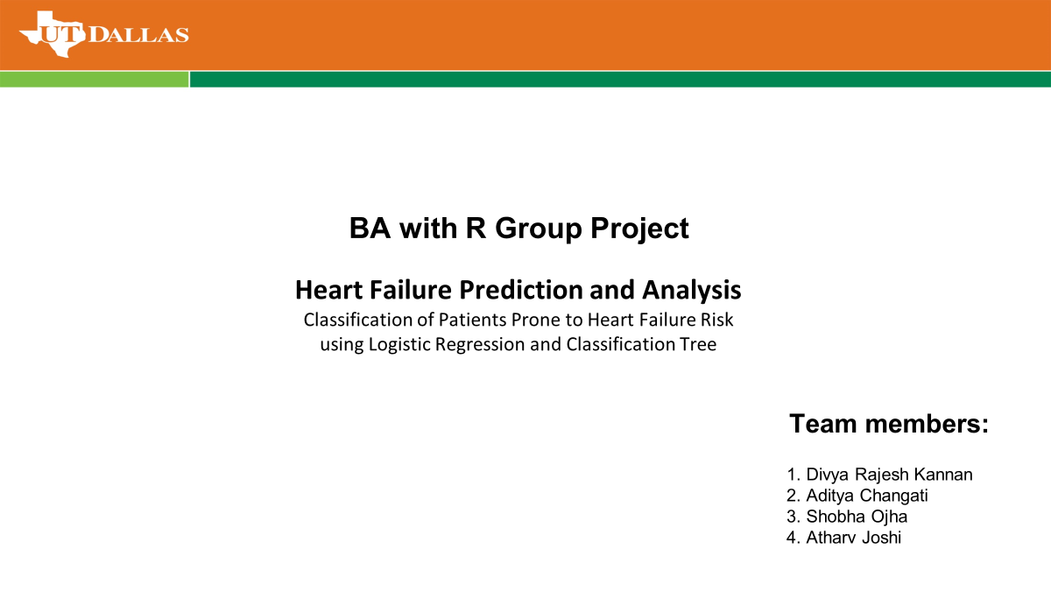

Slide 2
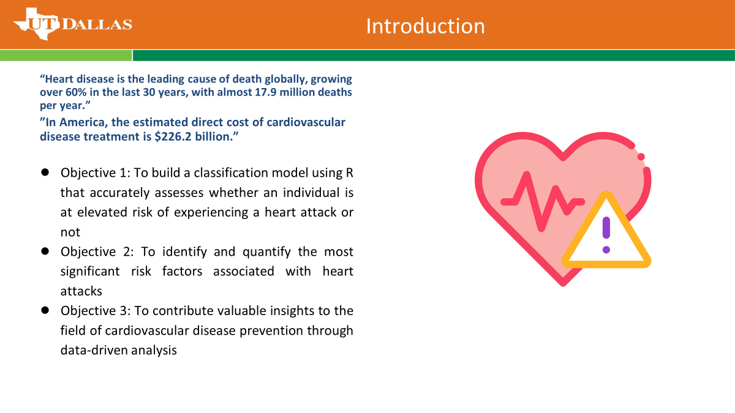
Heart Failure Prediction and Analysis Classification of Patients Prone to Heart Failure Risk using Logistic Regression and Classification Tree
Team members :
Divya Rajesh Kannan
Aditya Chaganti
Shobha Ojha
Atharv Joshi

Slide 3
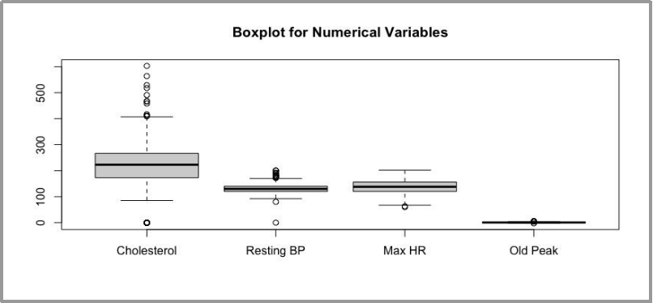
Data Preparation
Data exploration and summary measures
From initial analysis, it is seen that the Cholesterol variable has a high number of outliers
Usually, data with any outliers would be treated using the imputation or omission strategy. However, since it is medical data, it is important to take the nature and context of the data into account. In medical data, the outliers can represent valid and abnormal health conditions that need medical attention, hence treating it as an outlier would not make sense as valuable data would be lost

Slide 4
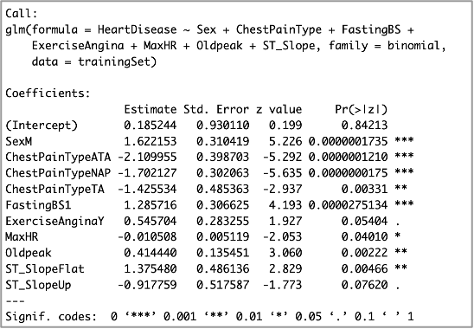
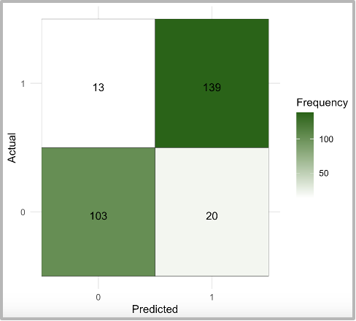
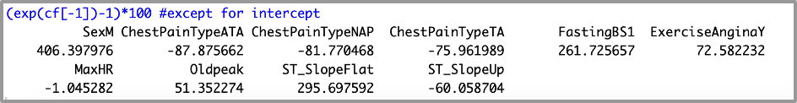
Model-1: Logistic Regression
(only significant variables, 70% training set)
Significant Attributes:
Sex
Chest Pain Type
Fasting Blood Sugar
Exercise Angina
Max HR
Old Peak
ST_Slope
Accuracy | 88.00
Sensitivity | 91.45
Specificity | 83.74

Slide 5
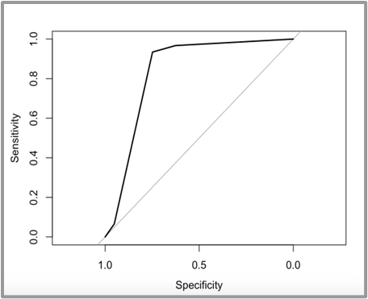
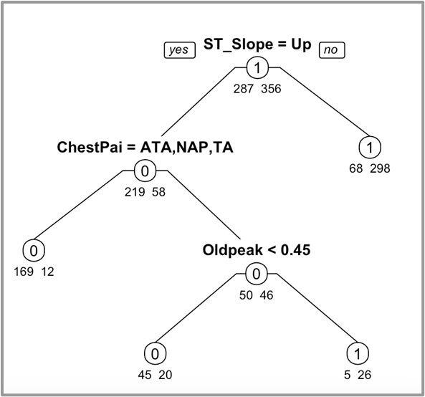
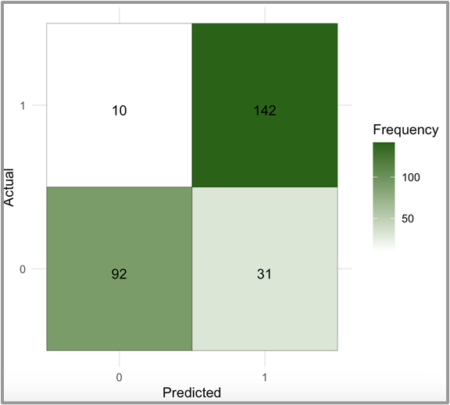

Model-2: Classification Tree
(Training set 70%)
● The training set for this model will contain 70% of total observations in the dataset, while the validation set will contain the remaining 30% of observations
● The resultant full tree has 12 possible complexity parameters, with the minimum error tree having CP = 0.0243902 and xerror = 0.37631 with 3 splits
● ROC Curve: this curve shows that the classification model outperforms the baseline model in terms of sensitivity and specificity across all cutoff values. Area under the curve = 0.8349 also reinforces this finding
Accuracy | 85.09
Sensitivity | 93.42
Specificity | 74.80

Slide 6
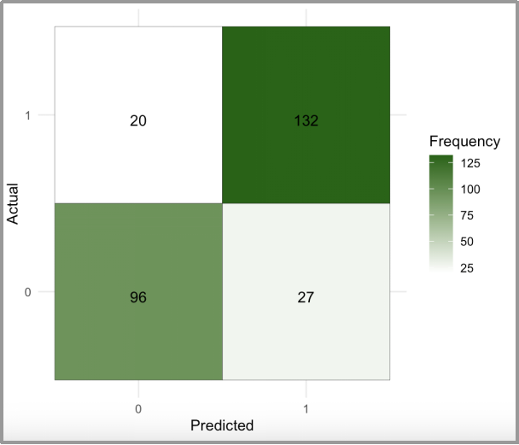
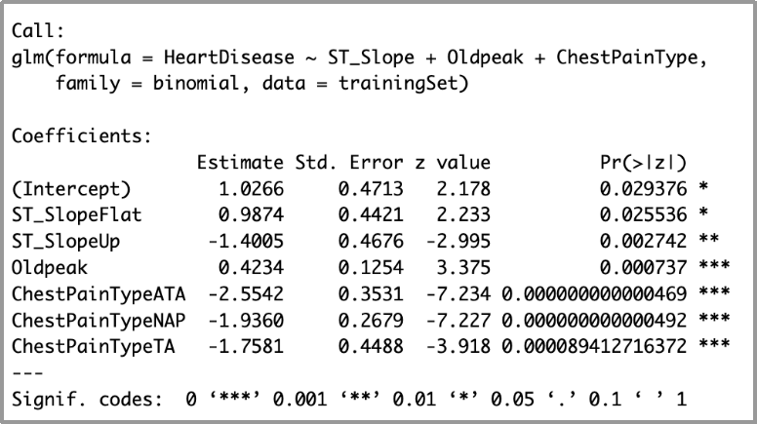
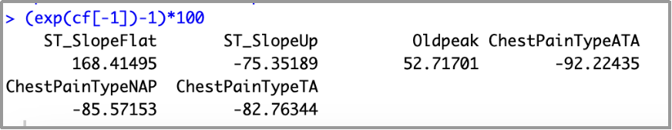
Model-3: Logistic Regression
(Using significant attributes from model-2)
The selected attributes are all statistically significant at p<0.05 except Resting BP in the training model.
● Accuracy, sensitivity & specificity of the training set are:
Accuracy: 83.20%
Sensitivity: 86.80%
Specificity: 78.75%
● The model is then run on the validation set to identify the performance measures of the model.

Slide 7
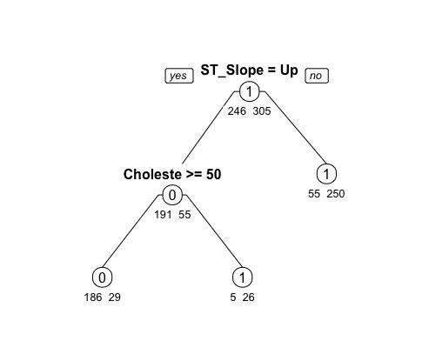
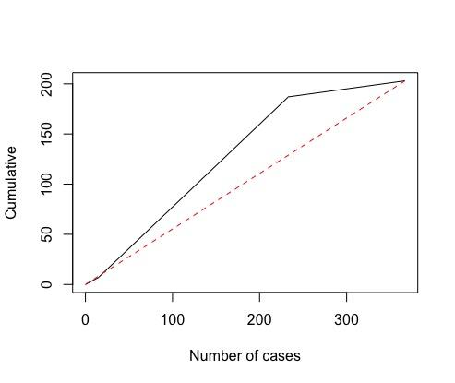
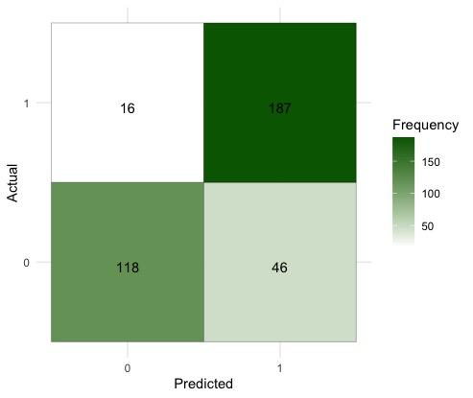
Model-4: Classification Tree
(decreasing training set to 60%)
● The training set for this model will contain 60% of total observations in the dataset, while the validation set will contain the remaining 40% of observations
● It is run using all 11 attributes, since classification models are commonly used for feature selection and to measure feature importance
● The full tree is run and continues to split nodes until each leaf node has minimum number of instances until a maximum depth is reached
Accuracy | 83.11
Sensitivity | 92.12
Specificity | 71.95

Slide 8
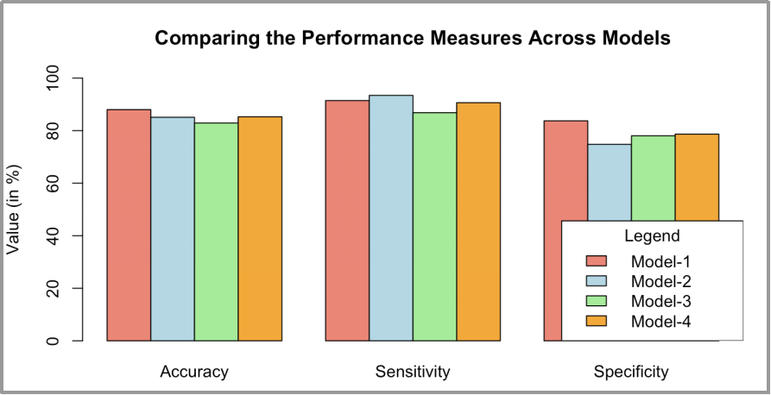
Performance Comparison
Findings
Accuracy is highest in Model-1 at 88%
Sensitivity is highest in Model-2 at 93.42%
Specificity is highest in Model-1 at 83.74%
Based on the models built, I would recommend Model-1 as the recommended model. Accuracy of predicting in the validation set is the most important measure of a robust model, and Model-1 has the highest accuracy at 88%. The sensitivity and specificity of Model-1 are also relatively high at 91.45% and 83.74% respectively. Keeping in mind that the business problem is to identify those with an elevated risk of heart disease, sensitivity is a very important measure, as it measures the proportion of correctly classified target cases i.e., those who are at risk for heart disease. Thus, Model-1 is recommended.

Slide 9
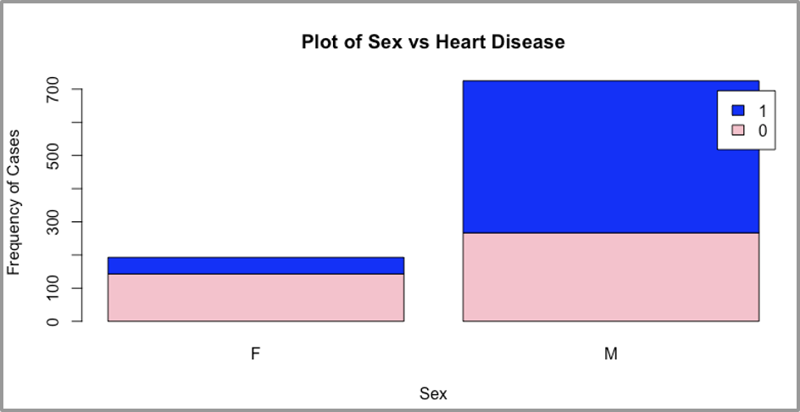
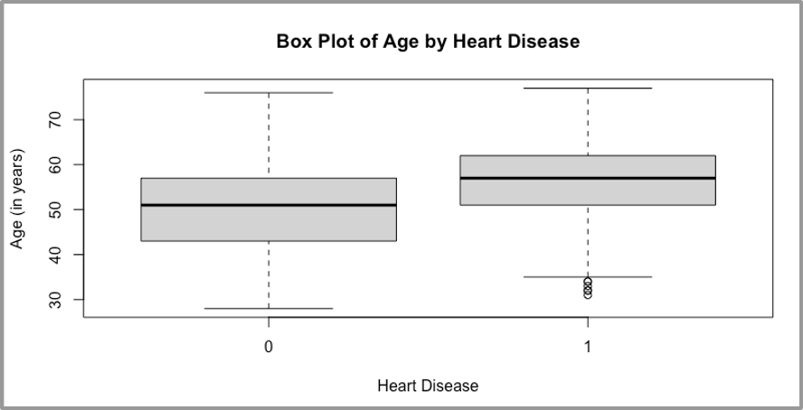
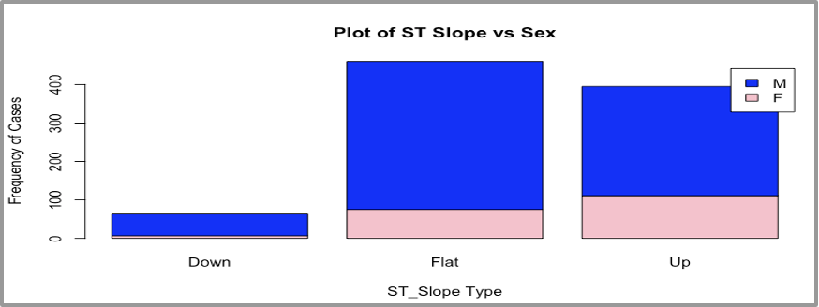
Visualization of Results
Males are 10x more susceptible to heart disease
57% of people having abnormal ST Slope have heart disease and 84% are males
Mean age of those with heart disease is higher, and outliers are young people, i.e. under 35 years

